Slide 1

DS-2002: Data Systems
Python and Databases

Slide 2
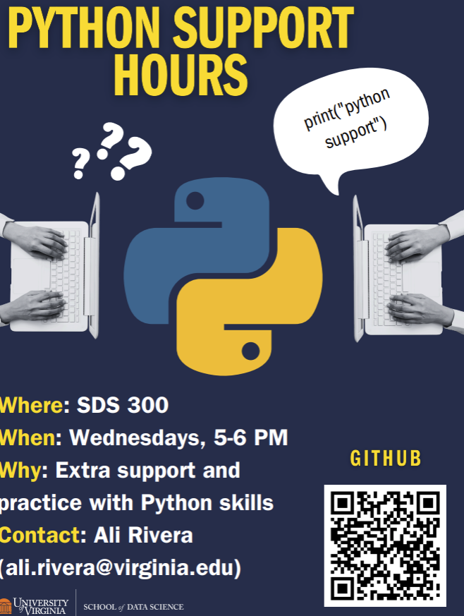
The 5 Before
Anaconda on your machine is awesome but not Required (It will make life easier for you). We’ll do that today
We’ll do a database quiz this week. Basic questions on Selects and joins.
Python Help is available →

Slide 3
Working with Python Anaconda
Install Example
What is a notebook
Anaconda (We’ll use this)
Kaggle (you are welcome to use this)
Notebook Basics
Talking to Databases
DS2002.ORG
Local Database
SQLITE

